Slide 1
Time Series Analysis
Yt

Slide 2
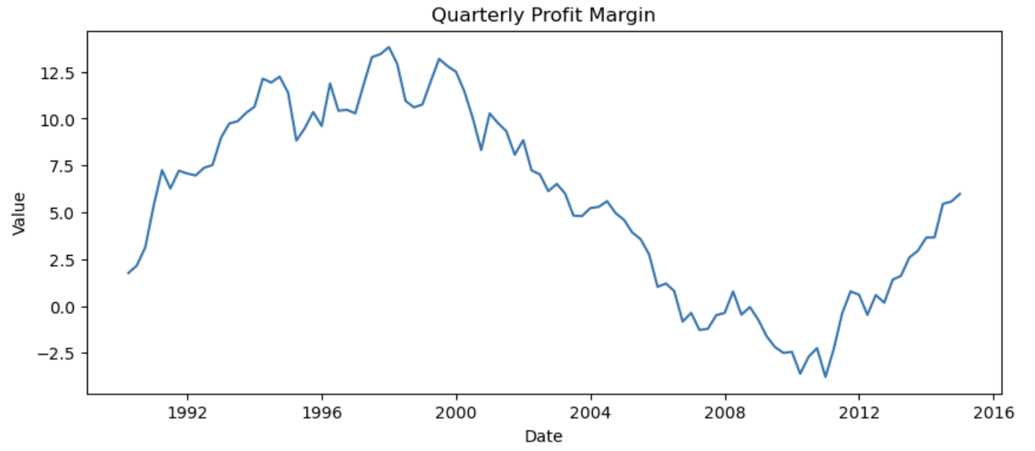
What is time series data?
Time Series Data: Data that is collected / recorded at regular intervals that is indexed / ordered chronologically.
Time Series Issues:
1) Stationarity
2) Seasonality
3) Trends
3) Autocorrelation

Slide 3
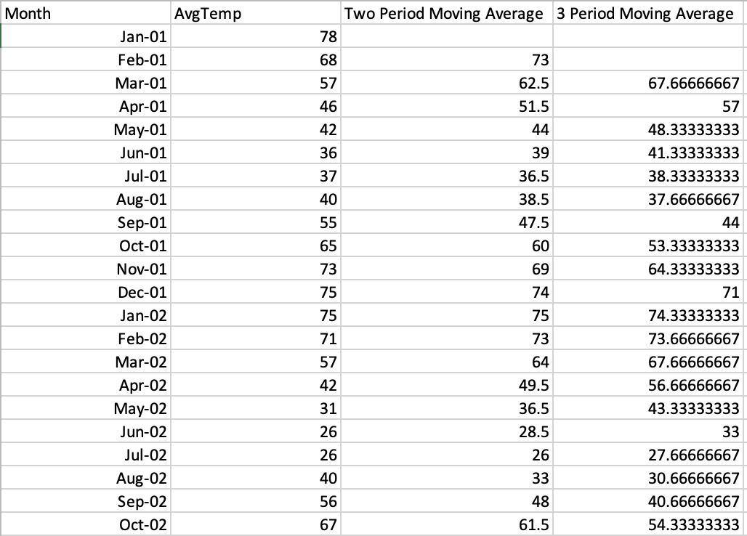
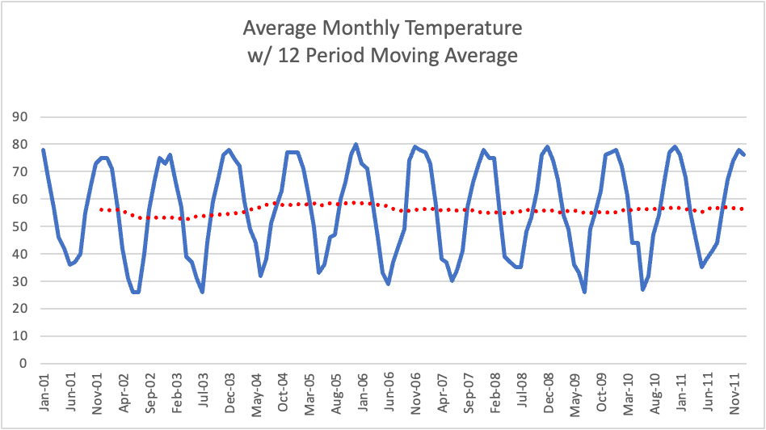
Smoothing Methods - Moving Averages
Moving Average: A succession of averages derived from successive segments of values, typically overlapping and equal length
Used to reveal underlying trends / remove seasonal / cyclical patterns
MA2 = Y = (Yt + Yt-1) / 2
MA3 = Y = (Yt + Yt-1 + Yt-2) / 3
And so on…

Slide 4
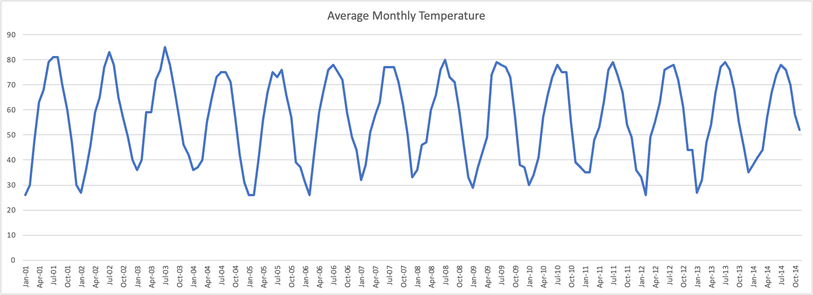
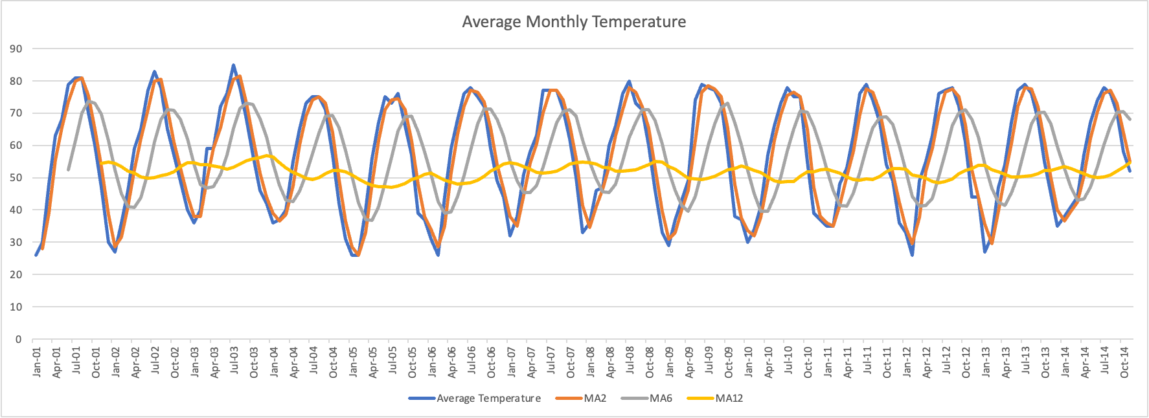

Slide 5
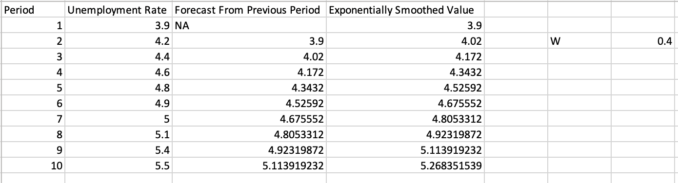
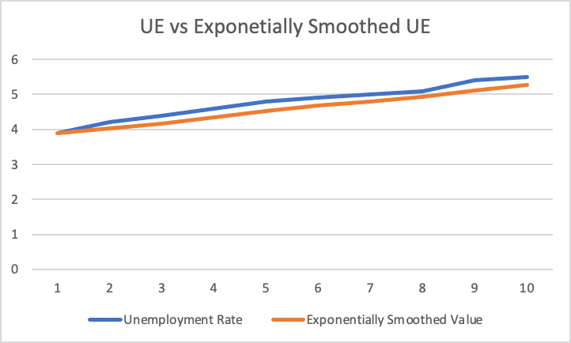
Smoothing Methods - Exponential Smoothing
E1 = Y1
Ei = WYi + (1-W))Ei-1
W ranges from 0 to 1 and is selected subjectively.
Smaller W = More Smoothing
Larger W = Better for forecasting
Yi+1 = Ei for forecasting one period ahead

Slide 6
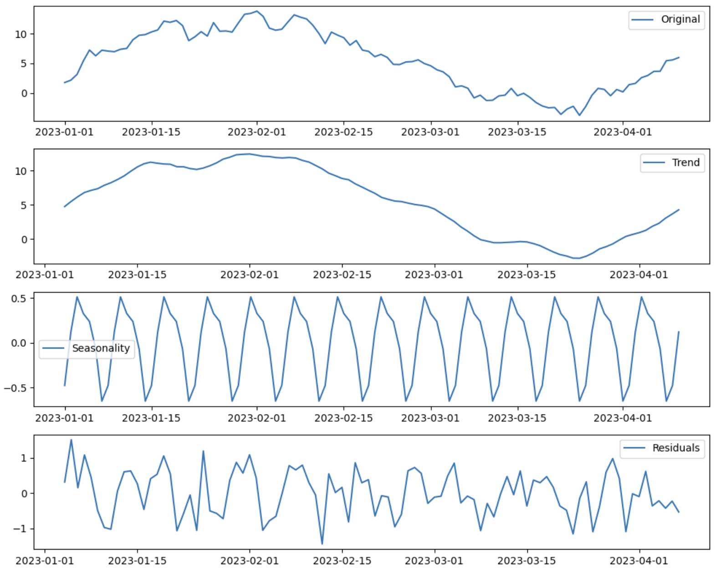
Time Series Components
Trend: The long term progression of a series that excludes short term fluctuations
Seasonality: Fluctuations that repeat over a specific period - regular
Cyclical: Fluctuations that do not repeat over a specific period - irregular
Noise / Error / Random: Fluctuations in the data that occur after trend, seasonality, and cyclical factors are accounted for.

Slide 7
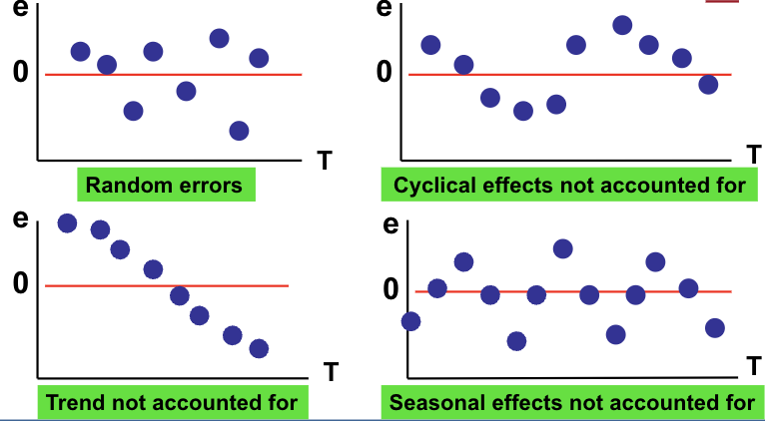
Time Series Residual Patterns
Plot errors vs time

Slide 8
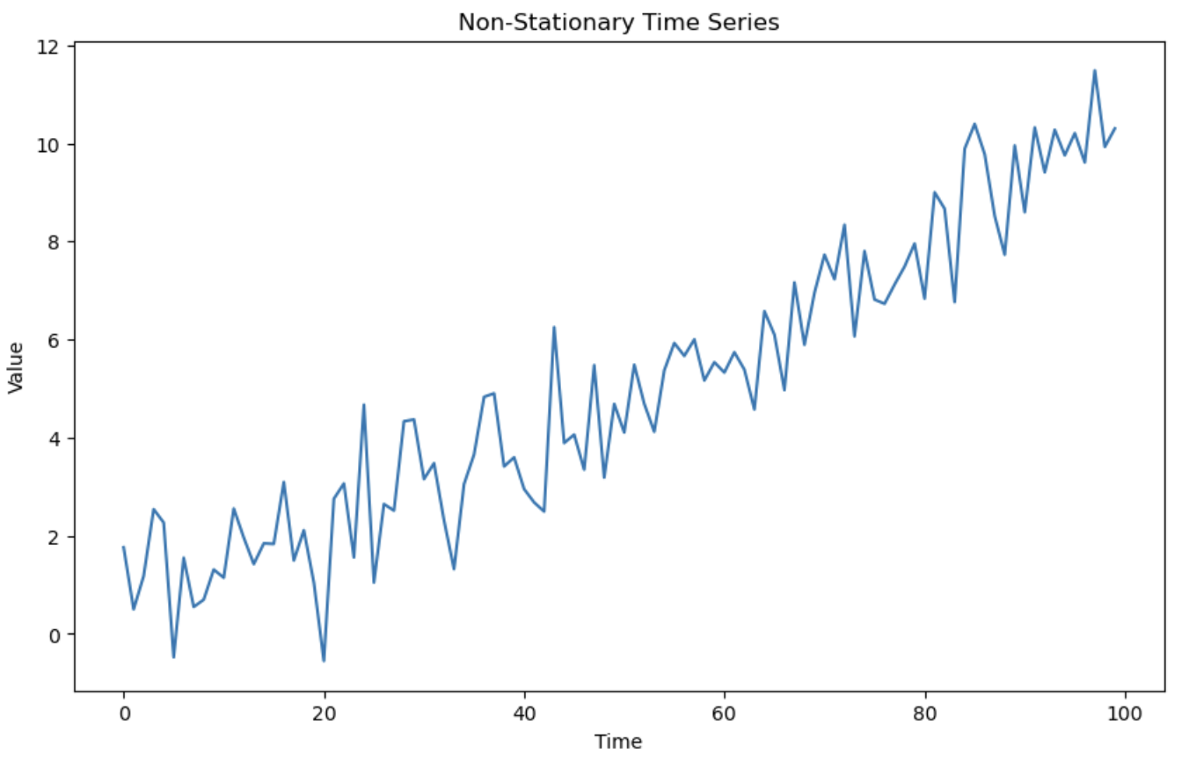
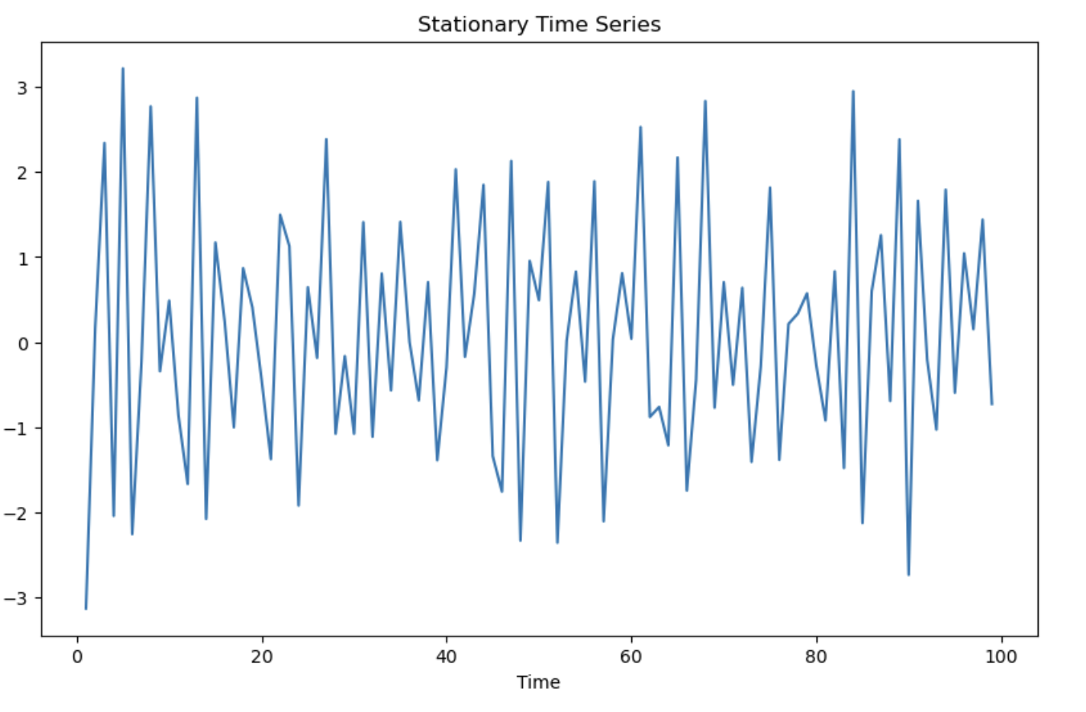
Stationary vs Non-Stationary Data
Stationary data has a constant mean and variance.
Often stationarity is required for proper forecasting.
If transformed to create stationary data, interpretation of model results may change.
Use Augmented Dickey Fuller test to for stationarity
HO: Non-Stationary, HA: Stationary
If p-value < alpha, reject the null that the data are non-stationary / conclude that the data probably are stationary

Slide 9
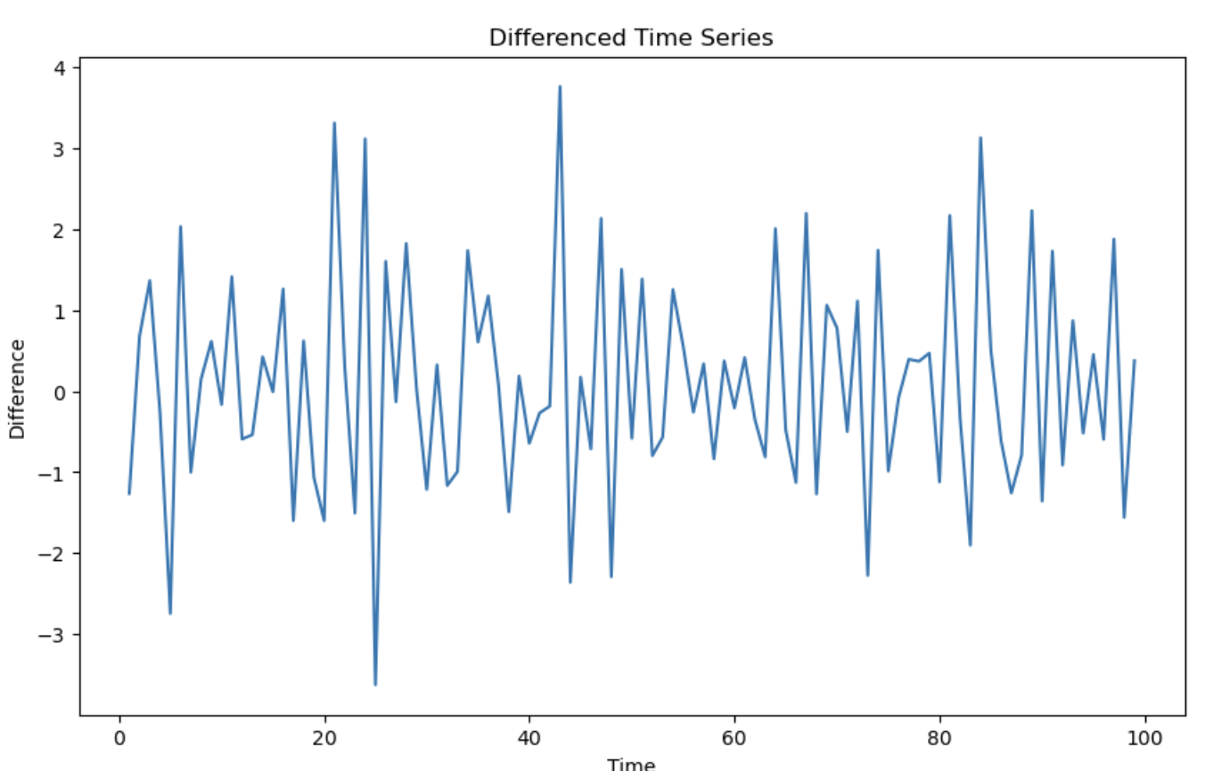
Differencing
Differencing: Transforming values in a time series by subtracting the prior value(s)
Used to make non-stationary data stationary
Interpretation of models may change*
First difference of Yt = Yt - Yt-1
Second difference of Yt = (Yt - Yt-1) - (Yt-1 - Yt-2)

Slide 10
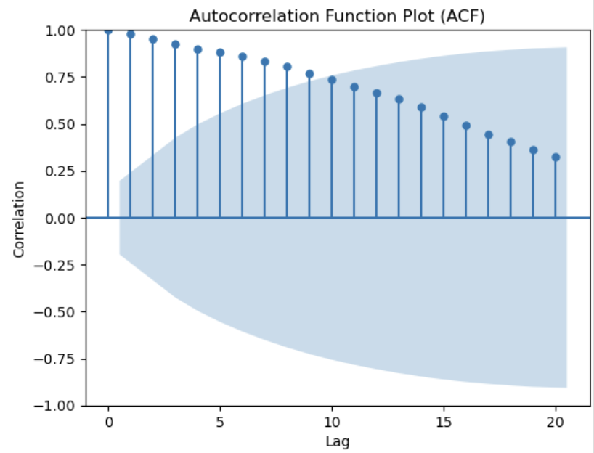
Autocorrelation Function Plot (ACF)
An ACF plot is a bar chart of the coefficients of correlation coefficient between a time series and its lagged values
A value of 0.75 when lag is 10 means the correlation coefficient between the series and its value 10 periods prior is 75%

Slide 11
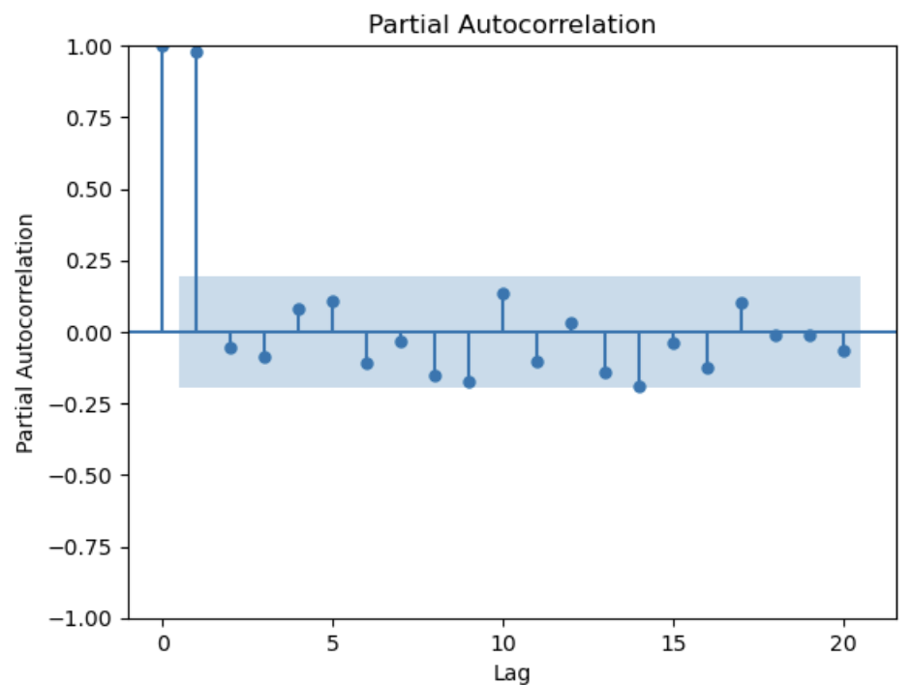
Partial Autocorrelation Function Plot (PACF)
An PACF plot is a bar chart of the partial correlation coefficient between a time series and its lagged values, controlling for the impact of all shorter lag values
A value of 0.75 when lag is 10 means the correlation coefficient between the series and its value 10 periods prior is 75%, after controlling for the impact of the dependent variable at lags of 1 through 9

Slide 12
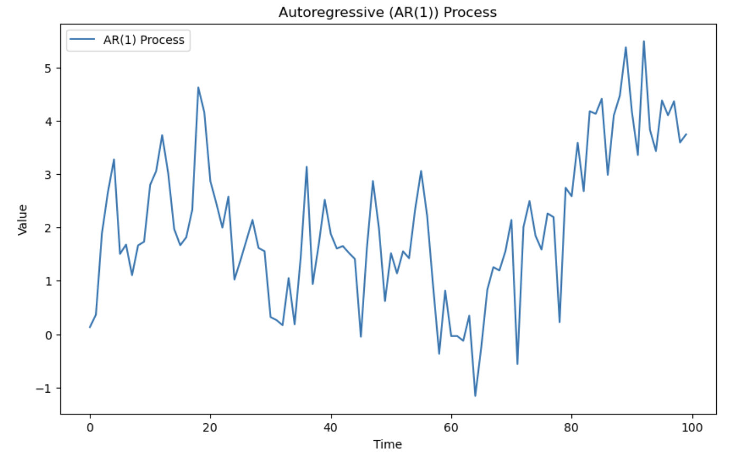
Univariate Time Series Models - Autoregressive Models
Autoregressive models explain Y in terms of past values of Y
AR(n): Yt = B0 + B1(Yt-1) + B2(Yt-2) + … Bn(Yt-n)
Assumptions:
1) Stationarity
2) Appropriate lag selection
4) No missing values
3) Well behaved errors*
5) Linearity*

Slide 13
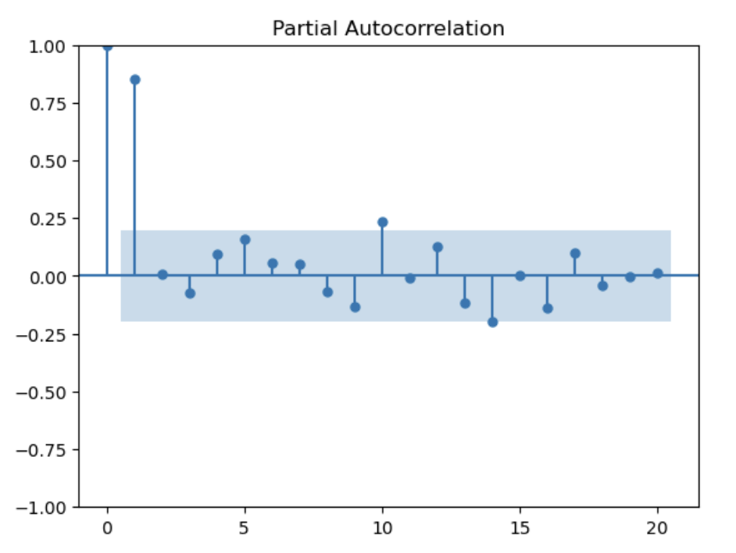
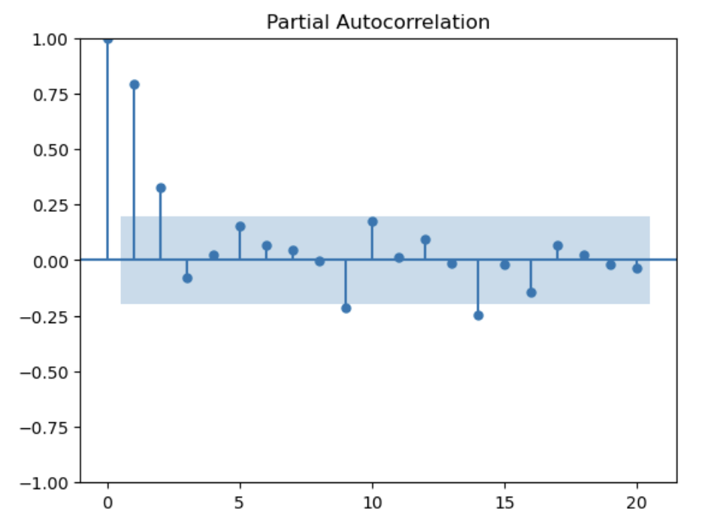
Selecting AR Lag Order
Compare AIC and BIC for models with different lag structures (lower is better)
Check PACF plots (vs ACF for MA)
Check fitted values vs residual plots

Slide 14
Univariate Time Series Models - Moving Average Models
Moving average models explain Y in terms of errors and past errors
MA(n): Yt = Mean + et + B1(et-1) + B2(et-2) + … Bn(et-n)
Assumptions:
1) Stationarity
2) Finite Order - Lagged errors beyond specified order do not influence current values
3) No missing values
4) Well behaved errors*
5) Linearity*

Slide 15
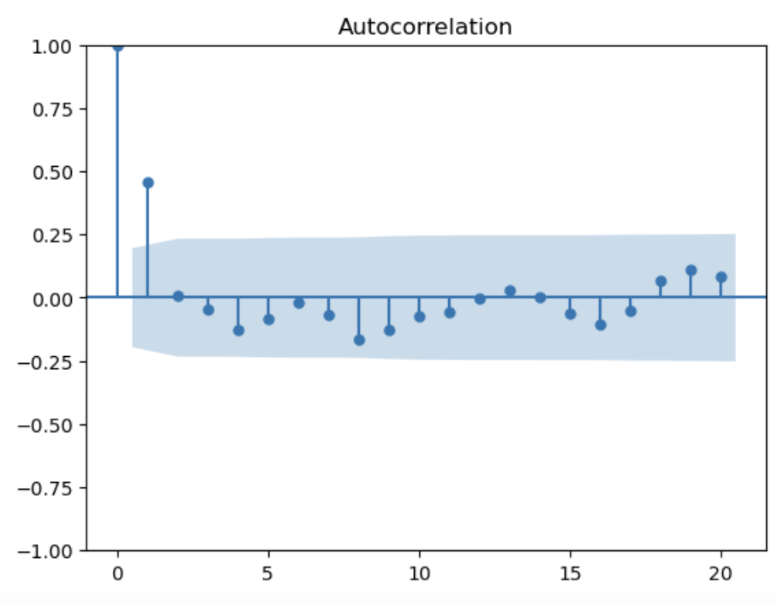
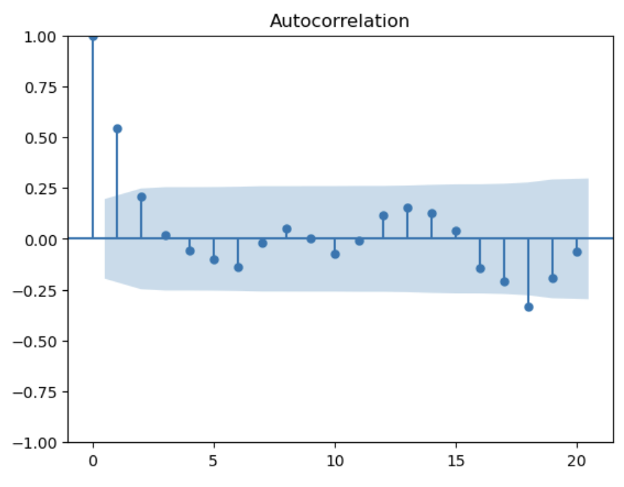
Selecting MA Lag Order
Compare AIC and BIC for models with different lag structures (lower is better)
Check ACF plots (vs PACF for AR)
Check fitted values vs residual plots

Slide 16
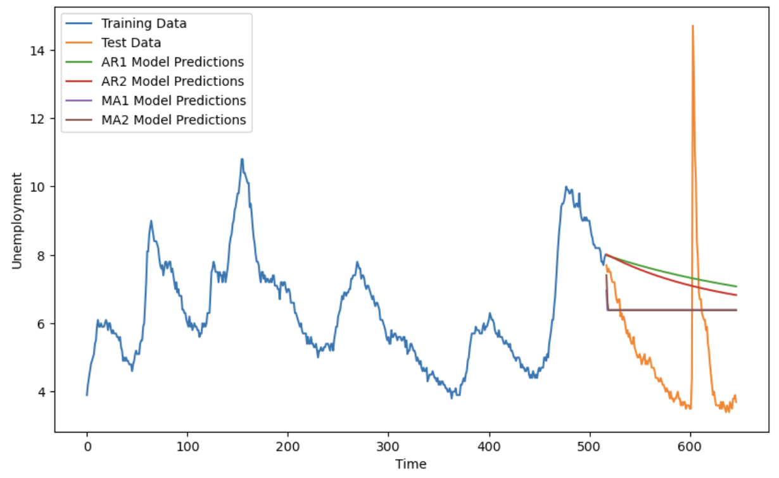
Forecasting with AR and MA Models
Plug (rolling) values into coefficients or use software to do it for you!

Slide 17
ARMA, ARIMA, and ARIMAX
ARMA = AR + MA
ARIMA = AR + Differencing + MA
ARIMA (p, d, q)
p = autoregressive term, d = differencing term, q = moving average term
ARIMAX = ARIMA + Exogenous Variables
https://people.duke.edu/~rnau/411arim.htm

Slide 18
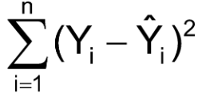
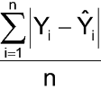
Model Comparison
Sum of Squared Errors
Mean Absolute Deviation

Slide 19
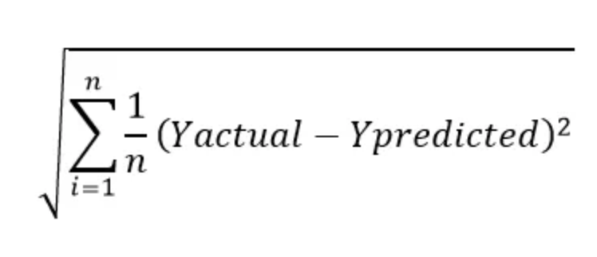
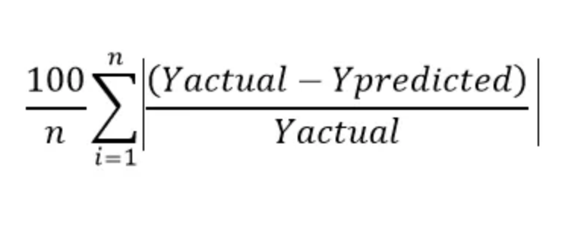
Model Comparison
Root Mean Squared Error
Mean Absolute Percentage Error

Slide 20
Vector Autoregression (VAR)
Coming soon, maybe

